Slide 1
Chapter 3: Operational Amplifiers
Module 3 : Non-Linear Applications
Reference: Robert L. Boylestad, Louis Nashelsky, Electronic Devices & Circuits Theory, 11th Edition, PHI, 2012

Slide 2
Objectives
Discuss different types of OPAMP based Comparators.
2. Discuss OPAMP based square wave generator circuit.

Slide 3
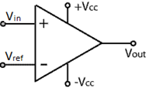

Voltage Comparator
Output voltage of a comparator is given by
$V_{out}$= +$V_{sat}$ when $V_{in}>V_{ref}$
$V_{out}$= -$V_{sat}$ when $V_{in}<V_{ref}$

Slide 4
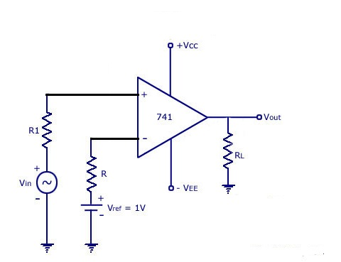
Non-Inverting Comparator
Signal given to Non inverting pin
Reference voltage given to inverting pin

Slide 5
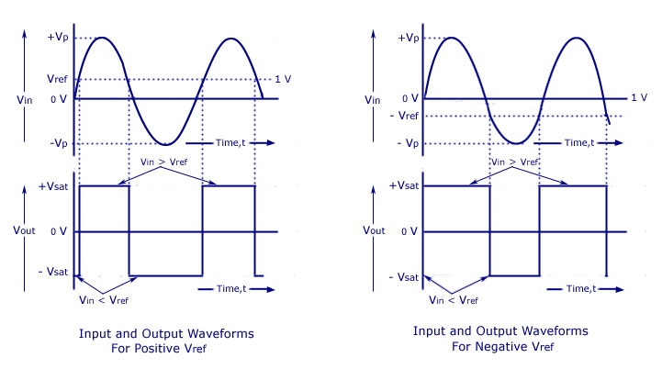
Waveforms

Slide 6
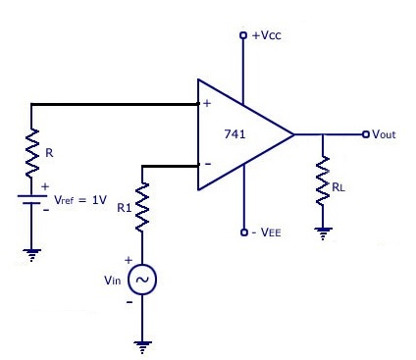
Inverting Comparator
Signal given to inverting pin
Reference voltage given to Non inverting pin

Slide 7
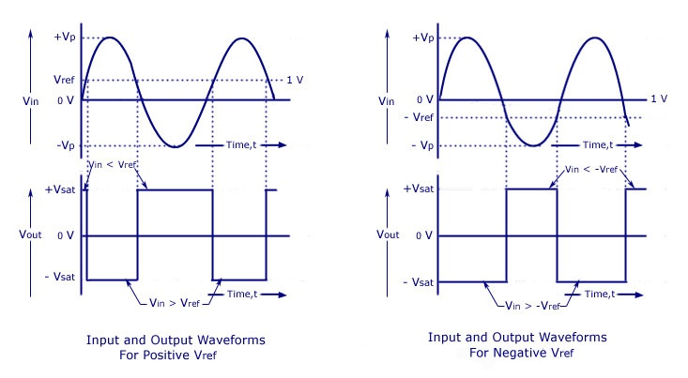
Waveforms

Slide 8
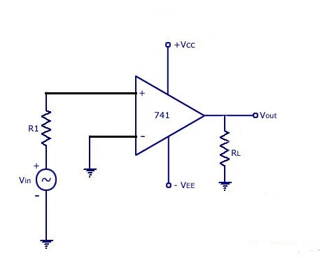
Zero Crossing Detector(Non-inverting)
Signal given to Non-inverting pin
Inverting pin grounded.
(Reference voltage=0V)

Slide 9
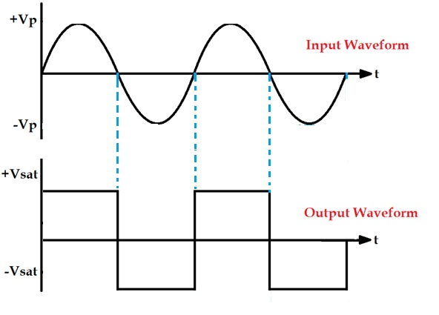
ZCD Waveforms

Slide 10
Exercise
Draw the circuit diagram and wave forms for zero crossing detector in inverting configuration
2. List the applications of the following circuits
*Non-Inverting comparator
*Inverting comparator
*Zero crossing detector

Slide 11
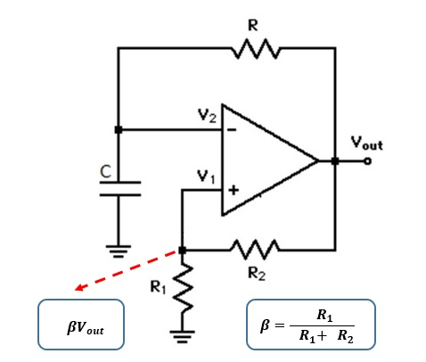
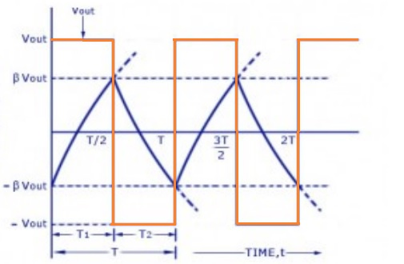
Square wave generator

Slide 12

Time period of the wave depends on RC value
T=2*RC*ln$\left\{\frac{1+β}{1−β}\right\}$
where $β$= $\frac{R_{1}}{R_{1}+R_{2}}$
Let $R_{1}$=$R_{2}$ ; $β$= 0.5
T=2*RC*ln$\left\{3\right\}$
T=2.2*RC
Corresponding frequency f=$\frac{1}{T}$ = $\frac{1}{\text{2.2∗}\text{RC}}$

Slide 13
Q1.Design an OpAmp circuit to generate a square wave of 1kHz

Slide 14
Triangular wave generator

